Slide 1
Network Externalities
B189

Slide 2
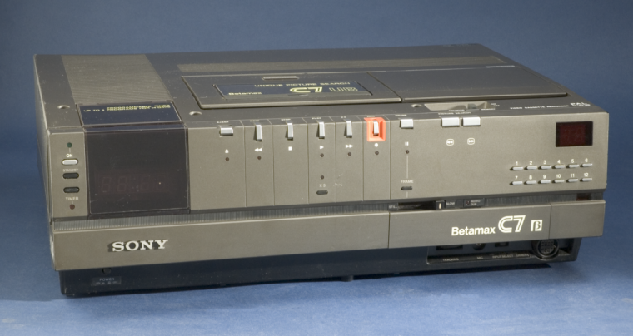
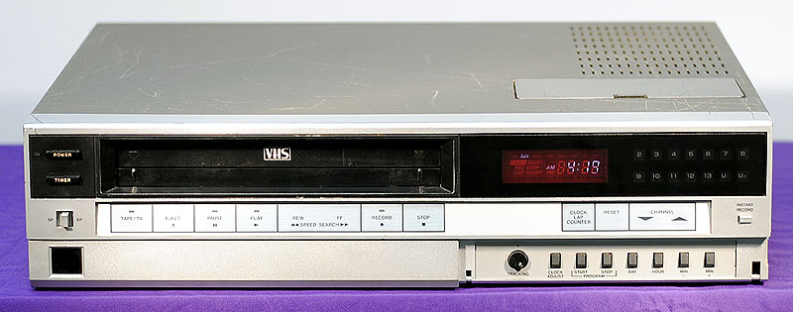
Competing standards (I)…

Slide 3
Competing standards (II)…

Slide 4
Definition
“A network externality exists when adoption is characterized by complementarily in consumption or production”.
Tirole, J. 1988. Theory of Industrial Organization. Cambridge, MA: MIT Press: p404
When a product’s value depends on the use or availability of other products or services

Slide 5
Direct and indirect externalities
Direct externalities
The telephone
The fax machine
MS Office
Google (search data)
Amazon (purchase history data)
Netflix (movie choices)
? Kaiser (treatment / health outcome data)
Indirect externalities
VHS / Betamax (content / players)
Record Players / CD Players (content / players)
HD DVD / BluRay (content / players)
Streaming content vs DVD (content / bandwidth)

Slide 6
E.g., Microsoft Office file format
More customers
More attractive option
Fewer
exchange costs

Slide 7
CD Players
Larger installed base (more buyers of digital music)
Players are more attractive to customers
(more content)
More attractive to record companies
Complementary product
More digitally recorded music
(CDs)

Slide 8
Firm or industry
Firm specific externalities
Symphony (Lotus) / MS Office (Microsoft)
VHS (Matsushita) / BetaMax (Sony)
HD DVD (Matsushita, Phillips) / Blu-ray (Sony)
Nintendo, Sega, PlayStation, X-box
In the age of “big data”
Google (Yahoo, Altavista, Lycos, Infoseek, Bing)
eBay (Yahoo)
Amazon…
Industry level externalities
The telephone
The fax machine
Vinyl / CD
QWERTY

Slide 9
Industrial Districts
Geographic Network Effects (“Regional Advantage”, AnnaLee Saxenian, 1994)
Easier to operate when:
Support infrastructure is well established
Labor pool is plentiful
Capital and expertize is close at hand
IP generation is local
Bay Area for
Computer hardware
Software and Apps
SF for
bio-tech
.com

Slide 10
Standards and technologies
Network externalities depend on a separation of one means or mode and another
CDs are digital etchings in a reflective surface. Vinyl uses a variable depth of groove in the surface.
These are incompatible technologies (you can put a CD on a turntable but you can’t ‘read’ it).
Other examples
MS .xls and Lotus .wks formats for spreadsheets
Linux and Windows programs
GSM, CDMA (IS-95B, Sprint, Verizon) and TDMA (IS-136, AT&T, DT, FT,TDK…) in mobile phones

Slide 11
Adoption issues
Excess Momentum
Networks externalities can force adoption, sometimes of an inferior technology, as companies rush to avoid missing the boat
Excess Inertia
Networks externalities can delay adoption as firms wait to see which technology or standard is likely to prevail
Mobile phones in the US
Networks externalities can prevent adoption of subsequent superior technologies
Windows and OS/2
QUERTY and Dvorak keyboards
eBay and Yahoo Auctions

Slide 12
Coordination, value creation and appropriation
Coordination may reduce individual appropriation in relative terms but increase total value creation overall
Smaller slice of a larger pie
Governments, industry associations or dominant firms sometimes ‘mandate’ one particular standard
GSM in Europe
110 volt AC domestic electricity supply, light bulb sockets (bayonet or screw), electrical wall plugs / sockets, railway track
IBM 370 architecture, PC-DOS

Slide 13
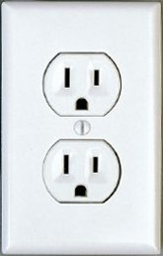
One example

